Slide 2
January Prayer Service
REBUILD

Slide 3
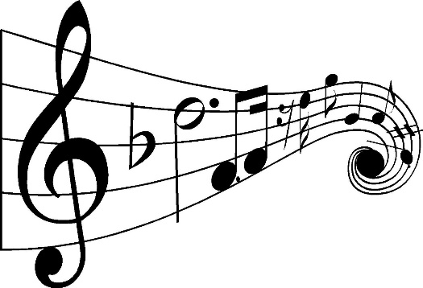
“All Are Welcome”
Marty Haugen
“City of God”
Dan Schutte
“Glory and Praise to Our God”
Dan Schutte
“A Rightful Place”
Steve Angrisano

Slide 4
Opening Prayer
God of generosity and goodness,
January is a time to evaluate and rebuild our habits and virtues, to refocus our lives and our need for wholeness.
Guide us and shape us, mold us and fashion us into your loving servants.
Amen. +

Slide 5
A Reading from the Book of Ezra
… the Lord stirred up the spirit of King Cyrus of Persia so that he sent a herald throughout all his kingdom, and also in a written edict declared: “Thus says King Cyrus of Persia: The Lord, the God of Heaven, has given me all the kingdoms of the earth, and he has charged me to build him a house in Jerusalem in Judah. Any of those among you who are of his people – may their God be with them! – are now permitted to go up to Jerusalem in Judah, and rebuild the house of the Lord, the God of Israel – he is the God who is in Jerusalem; and let all survivors, in whatever place they reside, be assisted by the people of their place with silver and gold, with goods and with animals, besides freewill offerings for the house of God in Jerusalem.” The heads of the families of Judah and Benjamin, and the priests and the Levites – everyone whose spirit God has stirred – got ready to go up and rebuild the house of the Lord in Jerusalem.
The Word of the Lord. R. Thanks be to God.
Notes:
I added this Call to Prayer and Opening Prayer on the next slide which frames the reflective questions on slide 8

Slide 6
Questions for Personal Reflection
“For the Jews returning to Jerusalem, the task of rebuilding Jerusalem must have seemed overwhelming. King Cyrus understood this and asked that family, friends, and neighbors help, by giving whatever they could.
Who has been there to help you when you have felt completely overwhelmed?
Is it easy or hard for you to ask for help when you are overwhelmed?
Notes:
A reading from the book of Job (Job 12:7-10,13)
Ask the animals, and they will teach you; the birds of the air, and they will tell you; ask the plants of the earth, and they will teach you; and the fish of the sea will declare to you. Who among all these does not know that the hand of the LORD has done this? In his hand is -the life of every living thing and the breath of every human being … With God are wisdom and strength; he has counsel and understanding.
The Word of the Lord. (Thanks be to God)

Slide 7
A Reading from the Annual Report of Development & Peace 2019-2020
Indonesia: participative urban development for the most marginalized
Our partner, Arkomjogja, is an association of community architects who work with poor and marginalized communities in urban areas that are prone to or affected by natural disasters. Through a consultative and participatory process with community members, Arkomjogja’s architects ensure that people have access to decent housing that meets the real needs of the community. The process not only seeks to transform slums into sustainable, well-organized, and community-friendly spaces, but also harnesses local and traditional knowledge. For example, a mapping method is used to identify the most important common spaces and local materials and traditional architectural methods are valued. At the end of this project:
Twenty community architects will have skills to improve buildings and facilities based on climate adaptation principles
Five cities will have guidelines for improving informal settlements based on climate
adaptation approaches and focused on citizen participation
Five community-based organizations will be trained to work towards providing adequate
housing as a human right in five cities
Notes:
A reading from the book of Job (Job 12:7-10,13)
Ask the animals, and they will teach you; the birds of the air, and they will tell you; ask the plants of the earth, and they will teach you; and the fish of the sea will declare to you. Who among all these does not know that the hand of the LORD has done this? In his hand is -the life of every living thing and the breath of every human being … With God are wisdom and strength; he has counsel and understanding.
The Word of the Lord. (Thanks be to God)

Slide 8
Questions for Guided Reflection
Are you aware of other D&P projects that have helped rebuild infrastructure in countries after natural disasters?
Can you imagine how difficult it would be to have everything you own, destroyed?
Notes:
A reading from the book of Job (Job 12:7-10,13)
Ask the animals, and they will teach you; the birds of the air, and they will tell you; ask the plants of the earth, and they will teach you; and the fish of the sea will declare to you. Who among all these does not know that the hand of the LORD has done this? In his hand is -the life of every living thing and the breath of every human being … With God are wisdom and strength; he has counsel and understanding.
The Word of the Lord. (Thanks be to God)

Slide 9
Closing Prayer
Stir up your spirit within us, God of Heaven and earth.
Remind us to support those around us who need assistance.
May we be generous in our response when disasters happen.
Rebuilding is always easier when we work together.
Amen. +
Notes:
A reading from the book of Job (Job 12:7-10,13)
Ask the animals, and they will teach you; the birds of the air, and they will tell you; ask the plants of the earth, and they will teach you; and the fish of the sea will declare to you. Who among all these does not know that the hand of the LORD has done this? In his hand is -the life of every living thing and the breath of every human being … With God are wisdom and strength; he has counsel and understanding.
The Word of the Lord. (Thanks be to God)

